Slide 1
The Gamble Plantation:
John Sims
Remembering Slavery
in Florida

Slide 2
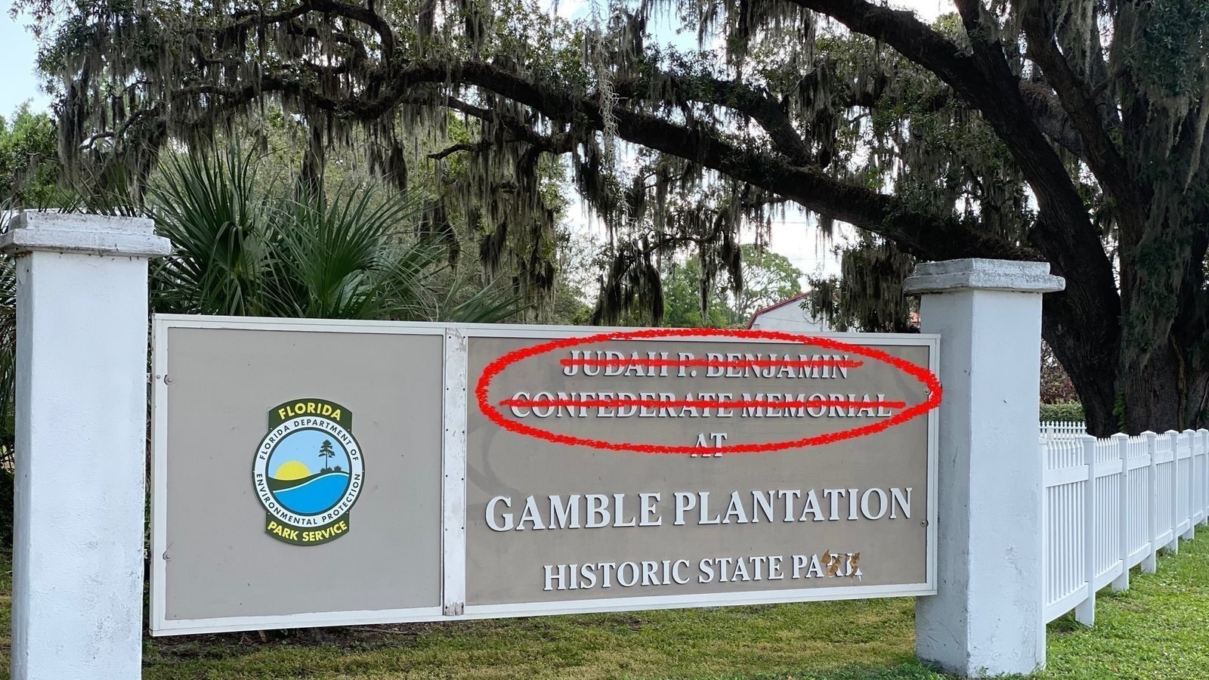
In this lesson plan, students will explore and discover ways contemporary art, history, and archaeology come together to uncover slave history at the Gamble Plantation, Manatee County, Florida.

Slide 3
Standards
Social Studies
Visual Arts
SS. 8.A.4.11 Examine the aspects of slave culture including plantation life, resistance efforts, and the role of the slaves spiritual systems.
SS.912.W.4.15 Explain the origins, developments, and impact of the Trans-Atlantic slave trade between West Africa and the Americas
SS.912.A.1.6 Use case studies to explore social, political, legal, and economic relationships in history
SS. 912.A.3.13 Examine key events & peoples in Florida history as they relate to US history
SS. 912.A.1.1 Describe the importance of historiography which includes how historical knowledge is obtained and transmitted when interpreting events in history.
VA. 912. H. 2.4 Research the history of art in public places to examine the significance of the artwork and its legacy for the future.

Slide 4
Learning Objectives
Students will be able to:
Identify and explain ways in which slavery can be examined at the Gamble Plantation;
Analyze the historical processes that hide the history of plantation slavery;
Evaluate ways contemporary art can reintroduce slave history into modern historic narratives.

Slide 5
Let's examine what we already know about plantations and plantation life
When I think of plantations and political systems, I think of....
When I think of plantations and economic systems, I think of....
When I think of plantations and social issues, I think of....

Slide 6
Let's examine silences in our understanding of plantations & plantation life

Slide 7
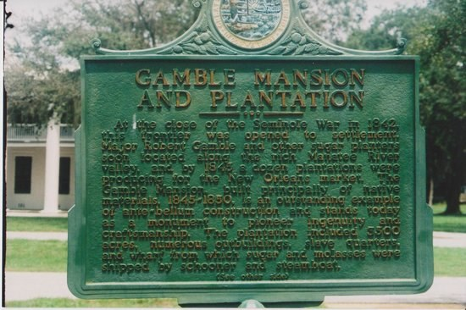
Using our thinking strategies, let's reflect:
What do I see in this image?
At first glance I see...
At second glance I see...
What do I not see in this image?
Why may that absence exist?

Slide 8
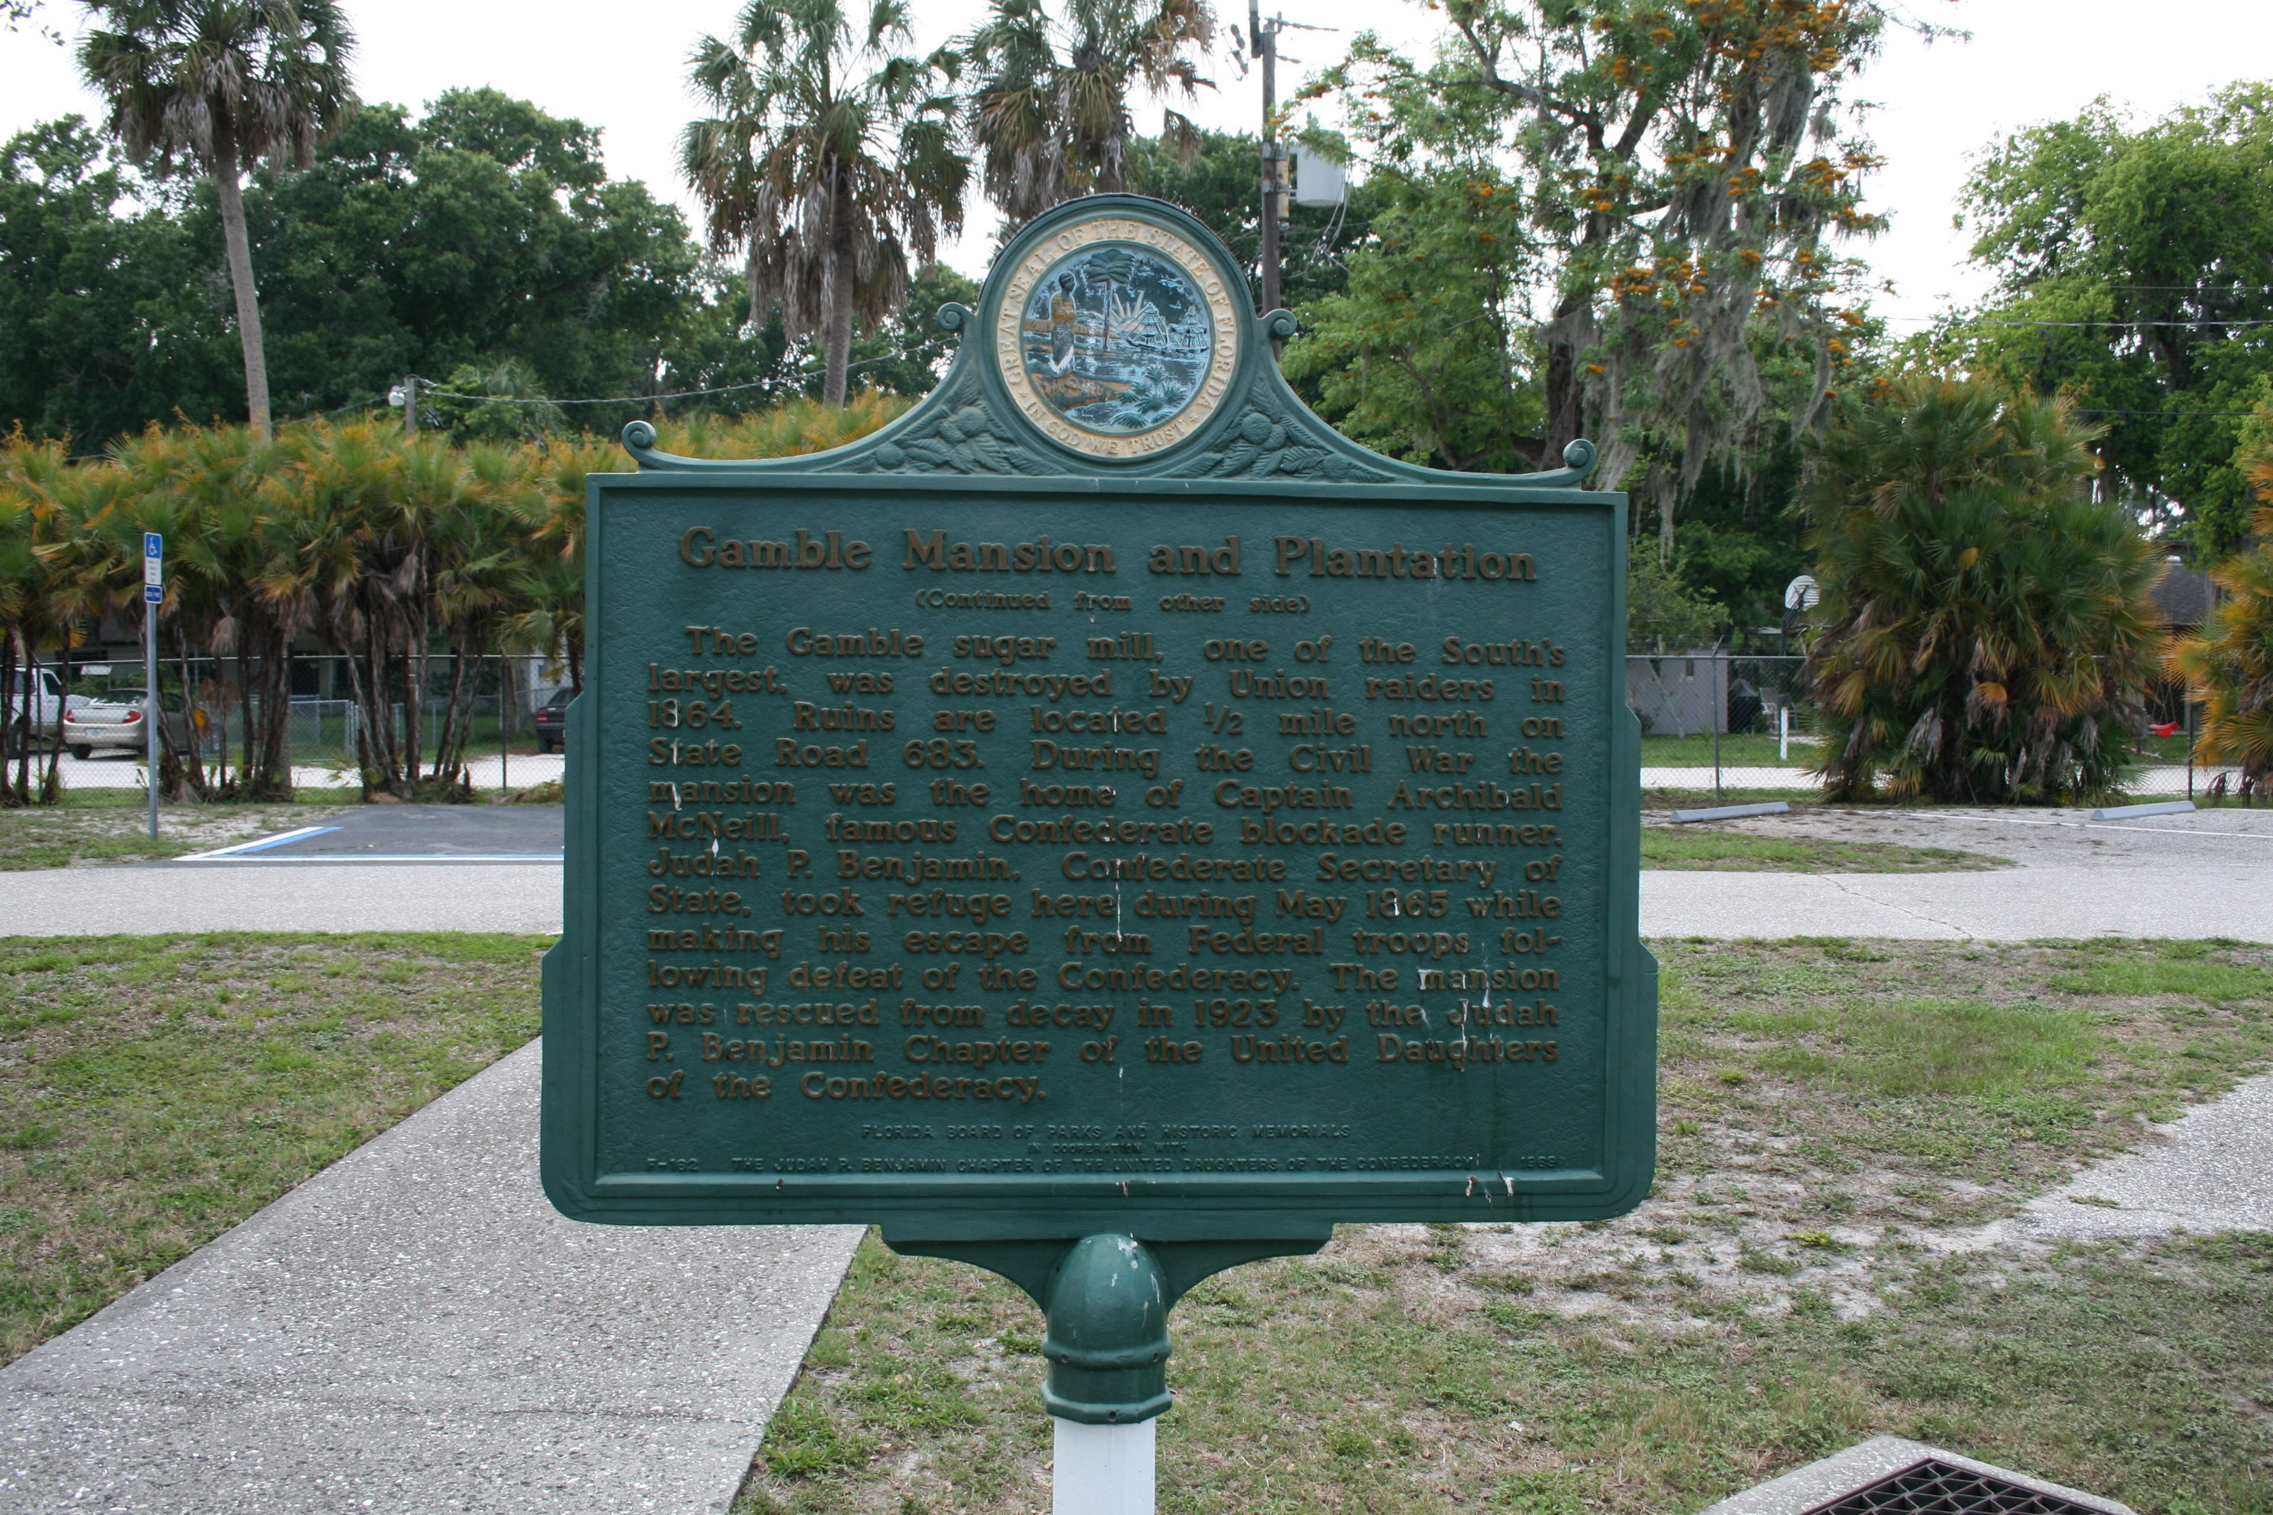
Using our thinking strategies, let's reflect:
What do I see in this image?
At first glance I see...
At second glance I see...
What do I not see in this image?
Why may that absence exist?

Slide 9
Using our thinking strategies let's reflect:
This image highlights the history of the Gamble Plantation on the official Florida State Parks and Recreation website.
What history is highlighted?
What history might be missing?

Slide 10
How do we know about slavery at the Gamble Plantation?

Slide 11
In an article for the Tallahassee Floridian, Gamble recalled the early days of his settlement in the area:
In 1844 I carried ten of my negro men to the river and commenced operations; this was just at the close of the seven years war with the Seminoles, so that after living in a stockade for that length of time upon the extreme frontiers of Middle Florida, I found myself again living upon the frontier, there being no white face between me and the everglades.
(Tallahassee Floridian, 28 September 1888)
This article is one of the few historical documents that mentions those held in bondage by Gamble. These 10 men were likely held by other members of the Gamble family prior to being relocated to South Florida.
Excerpt: Litteral, M. October 2019. An Archaeological Investigation of Enslavement at Gamble An Archaeological Investigation of Enslavement at Gamble Plantation. University of South Florida

Slide 12
The enslaved also dug 16 miles of canals, to create drainage, forever altering the marshy landscape along the river. These canals are still visible and functioning to this day. Enslaved laborers turned what was once swamp, into well drained and productive farmland. Enslaved Africans cleared the fields, planted and harvested the sugar cane that was brought to the mill, and processed the cane into molasses. Processing sugar requires a number of labor intensive steps; chopping the cane, grinding, and then heating the resulting liquid until sugar crystallization occurs. The labor cost of producing sugar would have been huge had Gamble, or other plantation owners, actually paid their laborers. The huge profitability of the sugar industry prior to emancipation depended upon the free labor of enslaved Africans.
LIDAR map of Ellenton showing canal system and possible slave quarters. Created by Litteral, M.

Slide 13
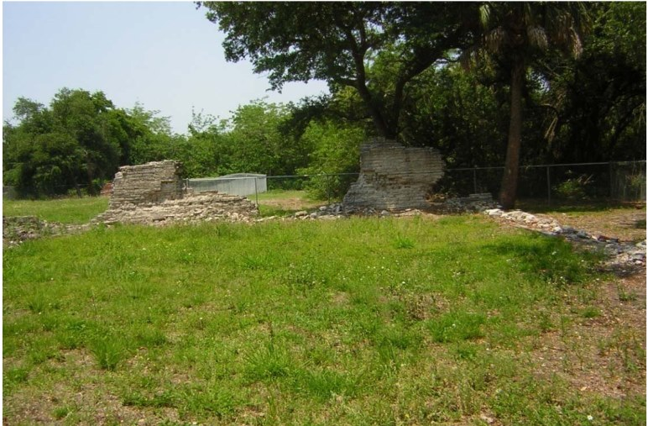
All these bricks were made on the spot and by my own force, and with the exception of one white workman, as boss brick layer, they were all laid by my own negroes; the most intelligent being selected and under the guidance of Mr. Godard, who was one of the “armed occupationists” and a master workman, they did good and loyal work. (Tallahassee Floridian, 28 September 1888)
Image: Gamble Sugar Mill (taken by Silpa, 2008).

Slide 14
Based on the documents, maps, and photographs, what role did slaves play in the establishment of the Gamble Plantation?

Slide 15
art of John Sims

Slide 16
By John Sims; published Aug. 28, Tampa Bay Times.
“This former plantation, as a historic state park, as a memorial to the enslaved African people who were on this land and beyond, as an apology to them and their descendants, is dedicated to the legacy of the seismic catastrophe of American slavery. This space marks a method of commerce, ownership and inhumanity that will forever haunt the spirit of a ‘free’ America. This space has been reclaimed to mark a place of possible transformative healing, where the enslaved becomes free, the shamed becomes washed and faith is restored in the universal sovereignty of human rights.”
The above text is my imagined rewrite of the main side of an historical marker currently on public display at the Judah P. Benjamin Confederate Memorial at the Gamble Plantation Historic Park in Ellenton. The original marker read more as a whitewashed brochure designed for Florida tourism, wedding planners and Make America Great Again hardliners. There is no mention that this sugarcane plantation had upward of 200 enslaved people at one point or that they built the mansion. The marker focuses more on the mansion as an “outstanding example of ante-bellum construction and stands today as a monument to pioneer ingenuity and craftsmanship” than on what it actually was: a slave plantation and a constitutional contradiction…
But where are the memorials to the slaves? Where are their markers? Where are their names?

Slide 17
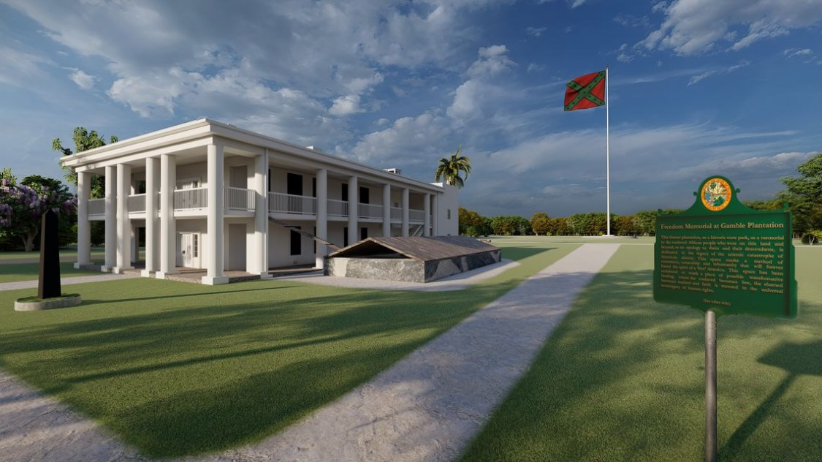
In front of the mansion, the artist and activist John Sims would have a black obelisk monument (left) inscribed in gold with all of the names of the last slaves on record who passed through the plantation in 1860. Behind the mansion, where sugarcane once grew and slaves once worked, there would be a gigantic flagpole springing from a fountain. And on the pole would be a giant square Confederate battle flag, recolored red, black and green, the colors of Black liberation, in the spirit that Black Life continues to be a daily battle. And near this flag monument there would be a marker that simply states: From the soil of bondage, reign of hope and light of justice will rise the fruits and flags of freedom.
[JOHN SIMS | Freedom Memorial at Gamble Plantation photo illustration by John Sims, 2020 ]

Slide 18
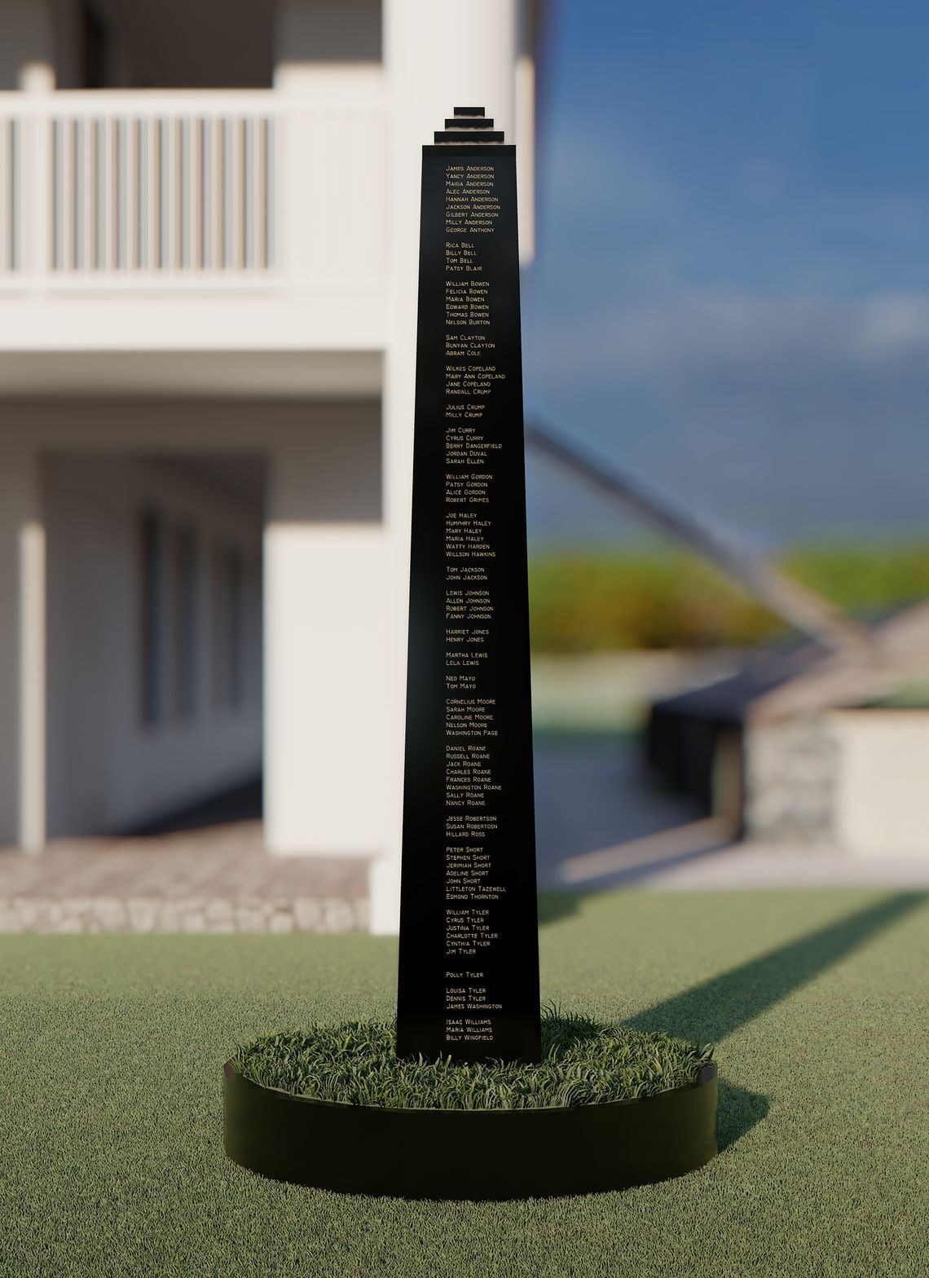
The author and artist imagines a black obelisk honoring slaves, a rewritten plaque and a new flag flown with the colors of Black liberation.
[ Freedom Memorial at Gamble Plantation photo illustration by John Sims, 2020 ]

Slide 19
Let’s Reflect
Questions:
What message is John Sims trying to make with his art at Gamble Plantation?
What is an installation and in what ways do you think art is important to the historical conversation?
In what ways does John Sims’ art installation address historic silences at Gamble Plantation?

Slide 20
Let’s Create
Two options:
If you were asked to rewrite the history page for the Gamble Plantation on the Florida Parks and Recreation website, how could you include the story of slavery?
OR
If you were asked to create an artist rendering of life at the Gamble Plantation for the Florida Parks and Recreation website, how could you include the story of slavery?

